Slide 1

Workshop session 2:
Make your own Kernel
Michael Denes – postdoc in parcels group

Slide 2
Agenda
A brief discussion on numerical modelling
Parcels kernels – what are they, how do they work, and particle variables
Notebook 1:
Creating a simple advection kernel
Creating a wind-induced drift kernel
Notebook 2:
Using parcels as an ODE Solver – The Lorenz attractor and the Lotka-Volterra predator-prey model
Kernel sharing session!

Slide 3
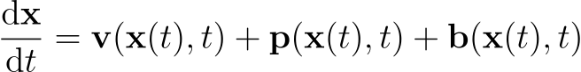
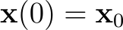
Numerical modelling of trajectories
The equation we are trying to integrate:
Water velocity
Particle-dependent
physics
Particle-dependent
behaviour
Buoyancy forces
Wind-drag
“missing”/unresolved physics from ocean models
Biofouling
Swimming
Dial vertical migration
With initial condition

Slide 4
Numerical modelling of trajectories
The equation we are trying to integrate:
Water velocity
Particle-dependent
physics
Particle-dependent
behaviour
Buoyancy forces
Wind-drag
“missing”/unresolved physics from ocean models
Biofouling
Swimming
Dial vertical migration
With initial condition

Slide 5
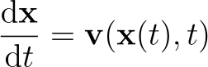
Explicit-Euler formation

Slide 6
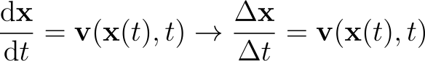
Explicit-Euler formation
Discretising

Slide 7
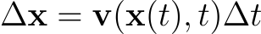
Explicit-Euler formation
Discretising
Displacement (change in position) = velocity $×$ timestep

Slide 8
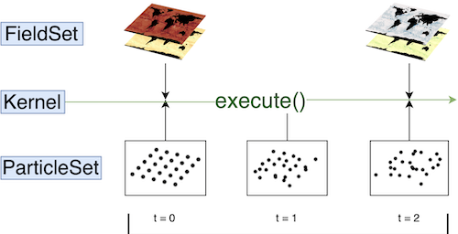
- structure

Slide 9
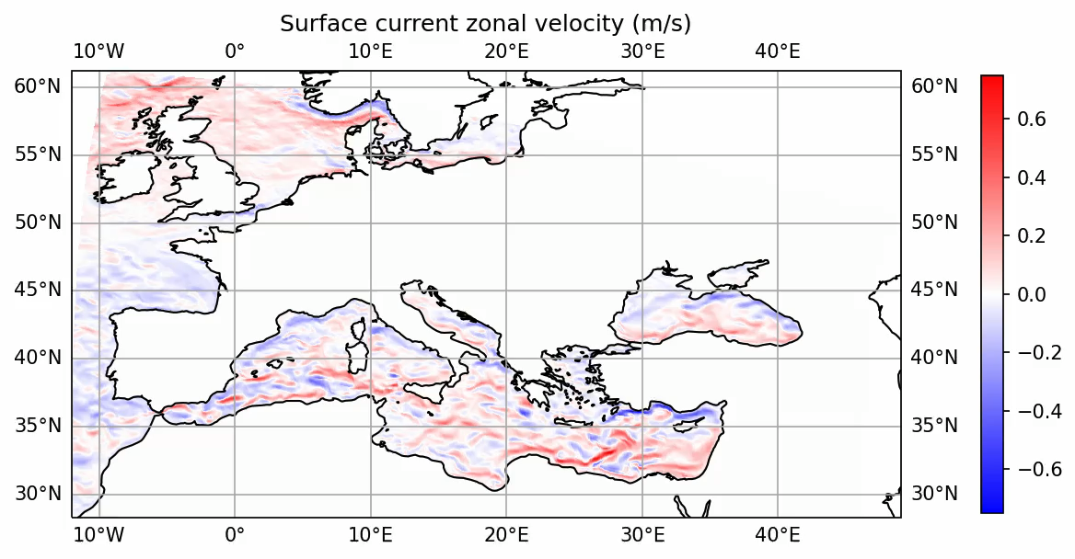
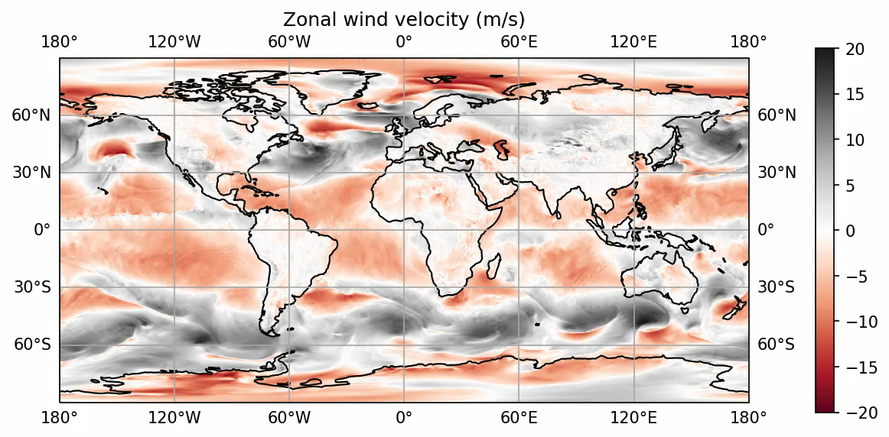
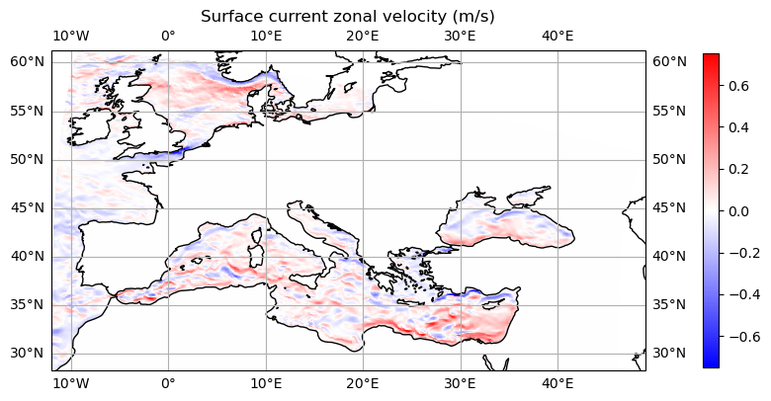
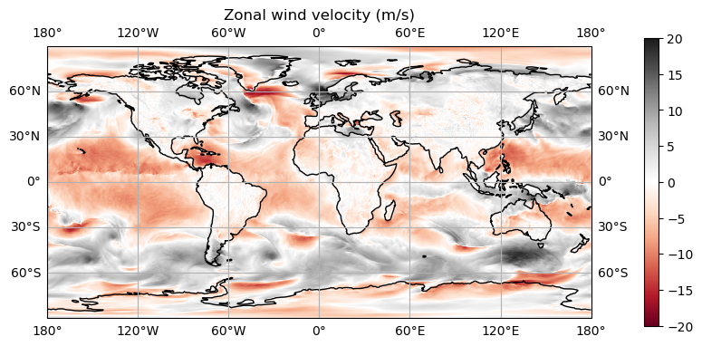








- structure
Ocean currents
Surface winds
Your kernels may require outputs on different grids at
different spatiotemporal resolutions
Custom kernels to simulate bio/chem/physical behaviour
Stokes Drift
Tuna Swimming
Windage
ARGO Floats
Biofouling
Icebergs
Sea-ice Capture
Turtle Drift

Slide 10
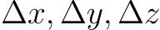
How do kernels work?
A particle has (at least) the following variables:
particle.lon (longitude in degrees, or x position in m)
particle.lat (latitude in degrees, or y position in m)
particle.depth (depth in m, *soon to be changed to z*)
At the beginning of each timestep, three “displacement/difference” variables are initialised to zero:
particle_dlon = = 0, particle_dlat = = 0, particle_ddepth = = 0
We loop through our kernels, using += or -= to update these three variables, and at the end of the loop, our positions will be updated automatically (e.g. particle.lon += particle_dlon - DON’T DO THIS YOURSELF).

Slide 11
How do kernels work?
A particle has (at least) the following variables:
particle.lon (longitude in degrees, or x position in m)
particle.lat (latitude in degrees, or y position in m)
particle.depth (depth in m, *soon to be changed to z*)
At the beginning of each timestep, three “displacement/difference” variables are initialised to zero:
particle_dlon = = 0, particle_dlat = = 0, particle_ddepth = = 0
We loop through our kernels, using += or -= to update these three variables, and at the end of the loop, our positions will be updated automatically (e.g. particle.lon += particle_dlon - DON’T DO THIS YOURSELF).

Slide 12
How do kernels work?
A particle has (at least) the following variables:
particle.lon (longitude in degrees, or x position in m)
particle.lat (latitude in degrees, or y position in m)
particle.depth (depth in m, *soon to be changed to z*)
At the beginning of each timestep, three “displacement/difference” variables are initialised to zero:
particle_dlon = = 0, particle_dlat = = 0, particle_ddepth = = 0
We loop through our kernels, using += or -= to update these three variables, and at the end of the loop, our positions will be updated automatically (e.g. particle.lon += particle_dlon - DON’T DO THIS YOURSELF).

Slide 13
How do kernels work?
NOTE: If lon and lat are in units of degrees, then particle_dlon and particle_dlat must compute displacements in units of degrees!
A particle has (at least) the following variables:
particle.lon (longitude in degrees, or x position in m)
particle.lat (latitude in degrees, or y position in m)
particle.depth (depth in m, *soon to be changed to z*)
At the beginning of each timestep, three “displacement/difference” variables are initialised to zero:
particle_dlon = = 0, particle_dlat = = 0, particle_ddepth = = 0
We loop through our kernels, using += or -= to update these three variables, and at the end of the loop, our positions will be updated automatically (e.g. particle.lon += particle_dlon - DON’T DO THIS YOURSELF).

Slide 14

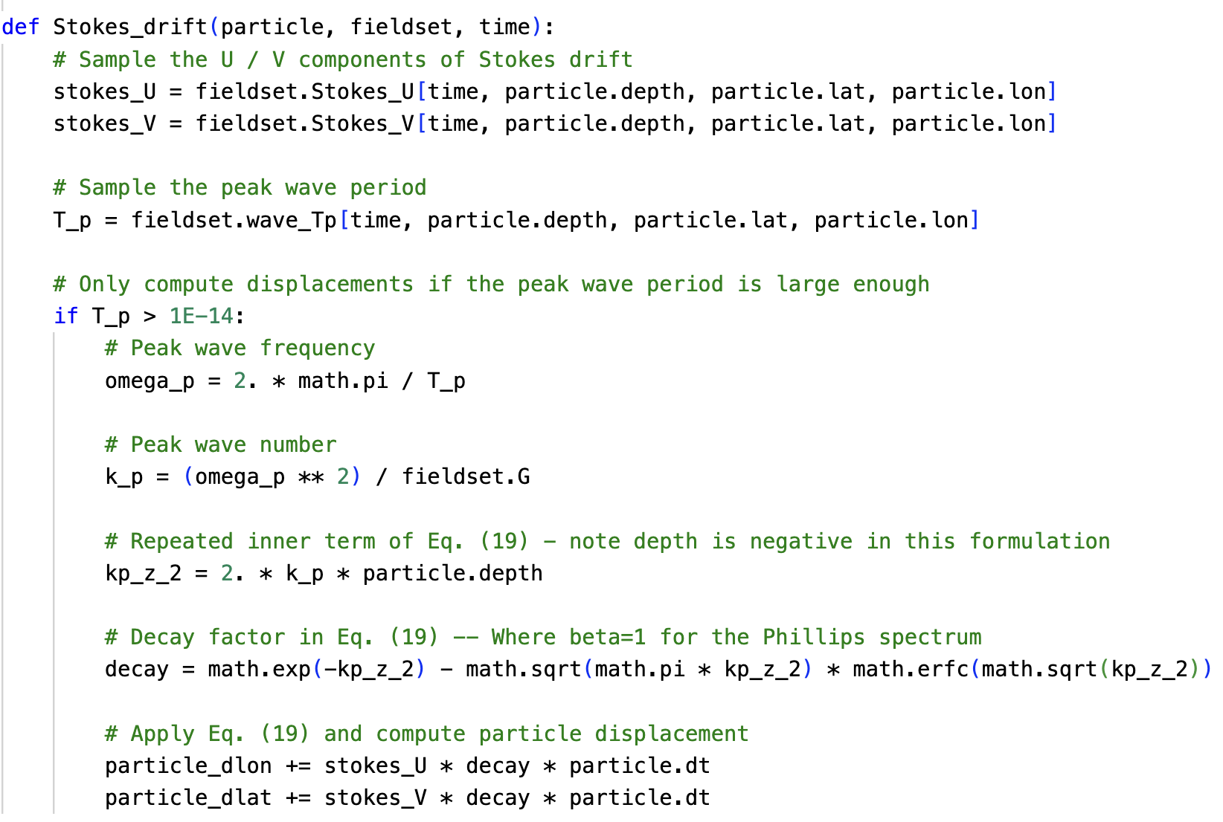

in-built kernels
Included particle dependent physics and behaviours
Stokes Drift
Breivik et al. (2016)
Wind-induced Drift
Biofouling
Kooi et al. (2017)
Sea-ice Capture*
Vertical Turbulent Mixing
Onink et al. (2022)

Slide 15
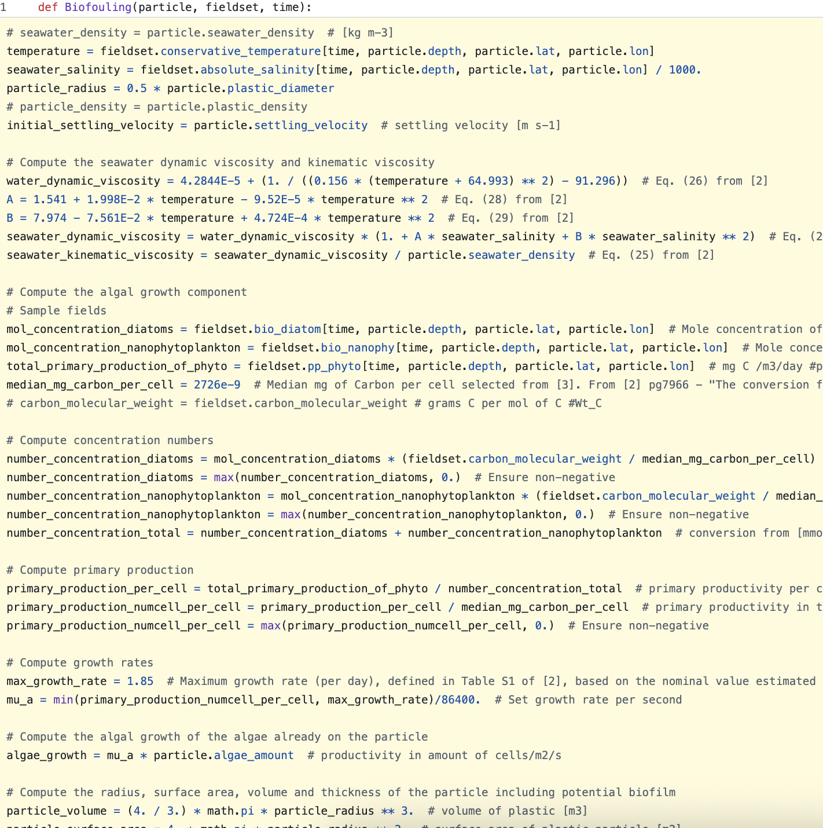
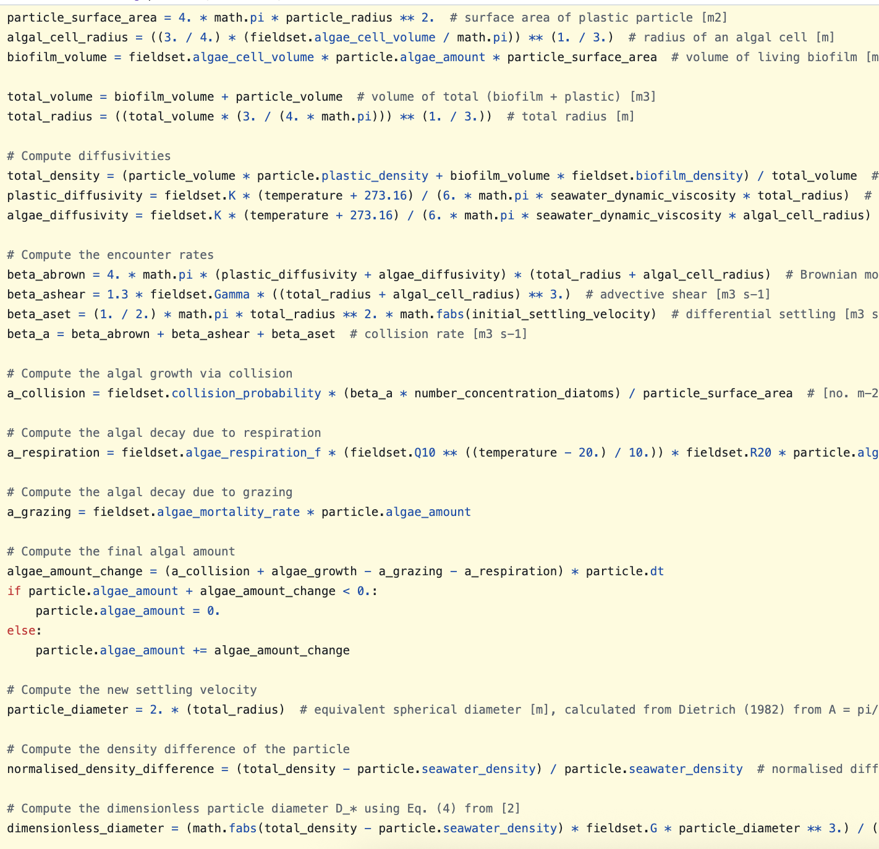
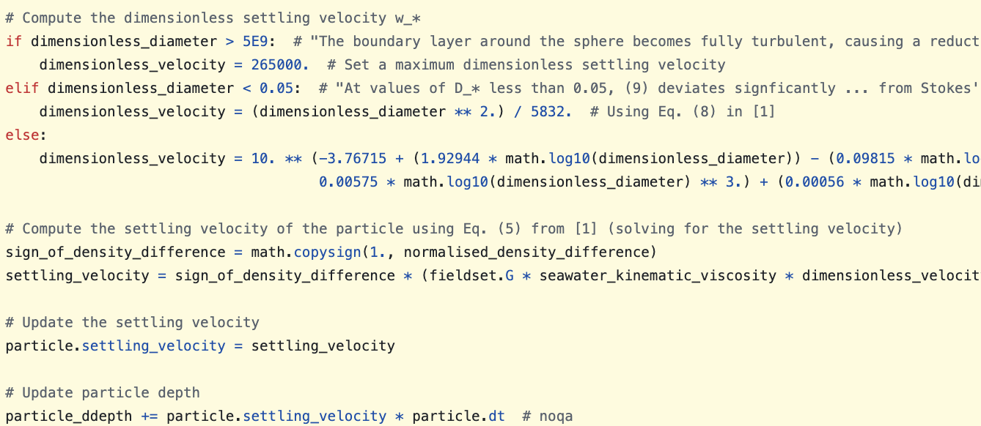

Slide 16
All this code just for a boring Euler-forward scheme….
(parcels v4 allows for calling functions!)

Slide 17
Parcels v3 tips (and quirks)
In parcels v3, there are two “modes” of simulations we can; using JIT (Just-in-time, code is compiled and run in C and using Scipy (code is run natively in python).
When using JIT mode:
Convert any integer into a float (e.g. 2/3 write as 2./3.)
Can’t use numpy, write everything using the math library
math.radians doesn’t work as you will see in the later notebook… make the conversion yourself!)
math.abs turns floats into integers, use math.fabs!
No function calls, or complex numbers, or ….
Pro tip: Develop your kernel in Scipy mode, using a single timestep to check the results. When using JIT mode, your JIT simulation should match your Scipy simulation. If they don’t likely one of the issues above has popped up!

Slide 18
Parcels v3 tips (and quirks)
In parcels v3, there are two “modes” of simulations we can; using JIT (Just-in-time, code is compiled and run in C and using Scipy (code is run natively in python).
When using JIT mode:
Convert any integer into a float (e.g. 2/3 write as 2./3.)
Can’t use numpy, write everything using the math library
math.radians doesn’t work as you will see in the later notebook… make the conversion yourself!
math.abs turns floats into integers, use math.fabs!
No function calls, or complex numbers, or ….
Pro tip: Develop your kernel in Scipy mode, using a single timestep to check the results. When using JIT mode, your JIT simulation should match your Scipy simulation. If they don’t likely one of the issues above has popped up!

Slide 19
Parcels v3 tips (and quirks)
In parcels v3, there are two “modes” of simulations we can; using JIT (Just-in-time, code is compiled and run in C and using Scipy (code is run natively in python).
When using JIT mode:
Convert any integer into a float (e.g. 2/3 write as 2./3.)
Can’t use numpy, write everything using the math library
math.radians doesn’t work as you will see in the later notebook… make the conversion yourself!
math.abs turns floats into integers, use math.fabs!
No function calls, or complex numbers, or ….
Pro tip: Develop your kernel in Scipy mode, using a single timestep to check the results. When using JIT mode, your JIT simulation should match your Scipy simulation. If they don’t likely one of the issues above has popped up!

Slide 20
Parcels v3 tips (and quirks)
In parcels v3, there are two “modes” of simulations we can; using JIT (Just-in-time, code is compiled and run in C and using Scipy (code is run natively in python).
When using JIT mode:
Convert any integer into a float (e.g. 2/3 write as 2./3.)
Can’t use numpy, write everything using the math library
math.radians doesn’t work as you will see in the later notebook… make the conversion yourself!
math.abs turns floats into integers, use math.fabs!
No function calls, or complex numbers, or ….
Pro tip: Develop your kernel in Scipy mode, using a single timestep to check the results. When using JIT mode, your JIT simulation should match your Scipy simulation. If they don’t likely one of the issues above has popped up!
v4 solves all these problems!!!

Slide 21
Notebook 1 - Developing advection and wind-induced drift kernels
Work in groups, and use: advection_and_windage.ipynb
Part 1
Create a second-order Runge-Kutta advection scheme
Compare trajectories vs. built-in parcels EE and RK4 schemes
Compare how changing timestep size affects your trajectories
Part 2
Create different wind-induced drift kernels
Compare trajectories!
Go here: edu.nl/h4y8w

Slide 22
Notebook 2 – Using parcels as an ODE solver
Work in groups and use: lorenz_and_lotka_volterra.ipynb
Part 1
Create different kernels to solve the Lorenz system
Compare trajectories and “Energy” to determine suitable solutions
Part 2
Create different kernels to solve the Lotka-Volterra system
Compare trajectories to determine suitable solutions
Go here: edu.nl/h4y8w

Slide 23
Kernel Sharing Session
Or kernel show-and-tell!
Let’s discuss/share some kernels that we have been working on!
Now is a good time to ask for help, guidance, or clarification.

Slide 24
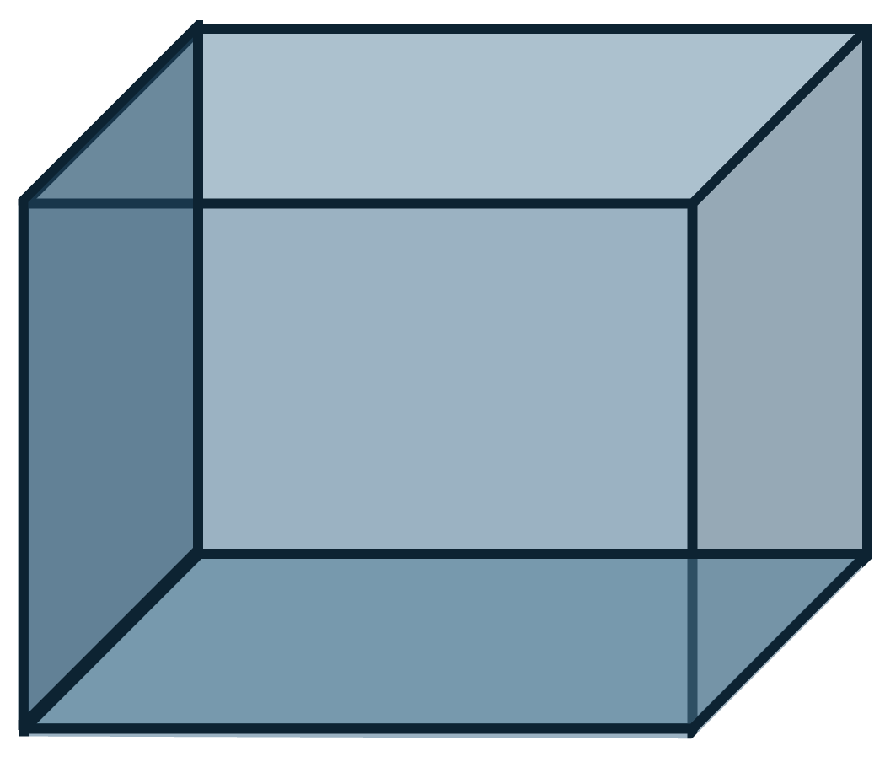
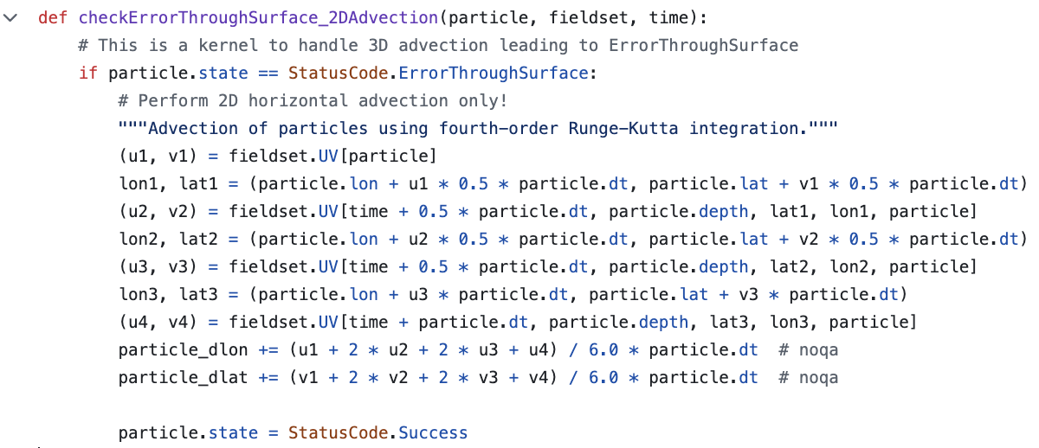
Bonus – An error handling example
Ocean surface

